Slide 1

10 – Docker & FOSS Projects
COMP 190 – Dickinson College
Prof. Braught
Fall 2020
Image from: https://www.docker.com/sites/default/files/d8/2019-07/Moby-logo.png

Slide 2
Docker is a set of platform as a service (PaaS) products that use OS-level virtualization to deliver software in packages called containers. Containers are isolated from one another and bundle their own software, libraries and configuration files; they can communicate with each other through well-defined channels. All containers are run by a single operating system kernel and therefore use fewer resources than virtual machines. - Wikipedia
Notes:
Docker is one (the most popular) container system.
For delivering software

Slide 3
Docker is a set of platform as a service (PaaS) products that use OS-level virtualization to deliver software in packages called containers. Containers are isolated from one another and bundle their own software, libraries and configuration files; they can communicate with each other through well-defined channels. All containers are run by a single operating system kernel and therefore use fewer resources than virtual machines. - Wikipedia
Notes:
Software, libraries and configuration files all bundled together.
That is the dependencies.
So for example as we’ll see you could have a docker container that
- has all of the dependencies for a project in place.
- then everyone has the same ones
- easy consistent setup.

Slide 4
Docker is a set of platform as a service (PaaS) products that use OS-level virtualization to deliver software in packages called containers. Containers are isolated from one another and bundle their own software, libraries and configuration files; they can communicate with each other through well-defined channels. All containers are run by a single operating system kernel and therefore use fewer resources than virtual machines. - Wikipedia
Notes:
Containers are isolated –
- cannot mess with the host machine
- cannot mess with each other
- good security
But, can when configured to do so, communicate with each other.

Slide 5
Docker is a set of platform as a service (PaaS) products that use OS-level virtualization to deliver software in packages called containers. Containers are isolated from one another and bundle their own software, libraries and configuration files; they can communicate with each other through well-defined channels. All containers are run by a single operating system kernel and therefore use fewer resources than virtual machines. - Wikipedia
Notes:
They are lighter weight than VMs
- not full hardware virtualization
- not a full OS
Instead, they use the host OS services.

Slide 6
Virtual Machines vs Containers
VM
App
App
App
App
Container
App
App
App
App
Libs/Bins
Libs/Bins
App
App
App
App
Guest OS
Guest OS
Libs/Bins
Libs/Bins
Libs/Bins
Hardware Virtualization
Virtual Machine (hypervisor)
Libs/Bins
OS Kernel Virtualization
Container Daemon (containerd)
Host Operating System
Host Operating System
Hardware
Hardware
Virtual Machines
Containers
Notes:
Normal system, hardware, os, libraries and binary files used by applications that run on the system.
With VM:
- software layer that pretends to be the computer hardware
- Can install OS on that virtual hardware
- Comes with its own libs/bins
- Apps run on that.
- Can have multiple VMs running on the same physical machine.
- Each can have its own full OS – mac / win / linux
With Containers:
- It is the OS that is virtualized
- So each container thinks it has its own OS
- But that OS is making use of the underlying host OS
- So eliminates the hardware virtualization
- But containers are all running on the same OS kernel

Slide 7
Virtual Machines vs Containers
Virtual Machines
Slow boot-up
Slower execution
Larger images
Apps are sandboxed*
Multiple OSs
Full GUI*
Containers
Fast spin-up
Faster execution
Smaller images
Apps are sandboxed*
Single OS
CLI access*
Notes:
Sandboxed – VMs may be more secure because of virtualized hardware and host OS
GUI/CLI
- technically possible to run VMs without GUI – often done on servers
- also possible to run GUI on containers – less useful – more cumbersome.

Slide 8
Container Uses
Development:
Container contains all dependencies and build tools.
Source files are stored and edited on host machine.
Deployment:
Container contains all dependencies and binaries needed to run the app.
Container can be “deployed” to a cloud service (AWS, Azure, Heroku, DigitalOcean, etc.)

Slide 9
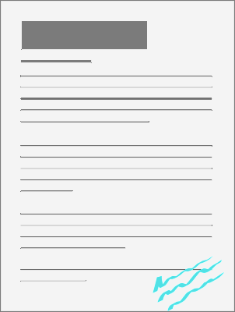

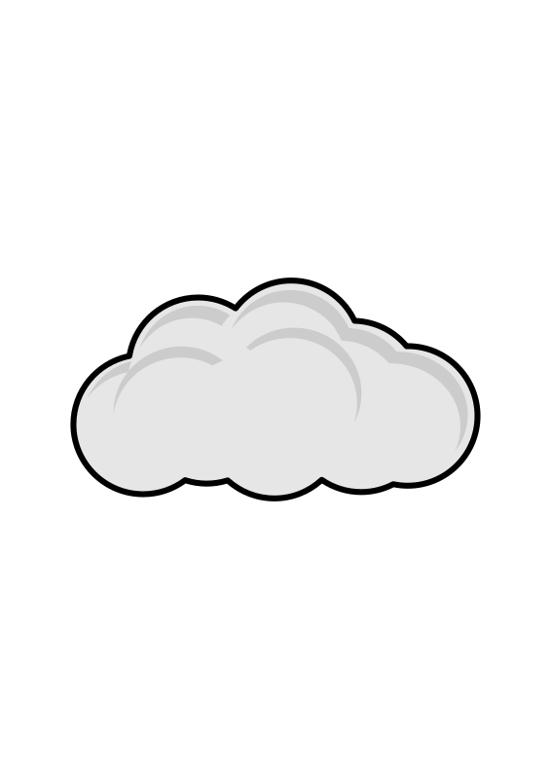

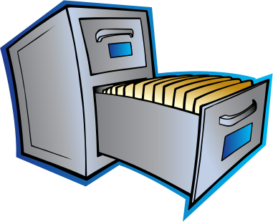


Docker Concepts
Cookie Container
Stew
Container
Via Metaphor:
Cooking recipes
Image Repository
Writeable
Layer
Local Images
Cookie:latest
Stew:9.7
pull
start
Stew:10.2
Stew:9.7
Stew:latest
remove
stop
image
remove
Salad:latest
create
container
Cookie:0.9
Cookie:latest
Image from: openclipart.org
Notes:
Repository
- Cloud service that stores recipes
- Images are recipes
- possibly with back versions that are tagged
- read only for the public
Local Images
- Downloaded (pulled) version of of the image:tag
- still read only – like a pdf file
Image used to create a container
- like printing the recipe on a piece of paper and putting in a file.
Starting the container
- taking the recipe out and putting it on the counter
- can use it
- can modify it and make notes on it
- writeable container layer
Stopping a container
- putting it back in the file
- with all notes on it.
- can start it again and it will come back as is.
Removing a container
- like shredding the paper.
- all notes are gone
- can create a new container from the image
- resets to initial state
- all notes (the writeable layer) is gone
Removing the image
- Like deleting the pdf file.

Slide 10
Docker Concepts
Image Repository
Docker Hub is “a hosted repository service provided by Docker for finding and sharing container images.”
Image:tag
An image is a read-only file containing the libraries, binaries, application and configuration files for creating a container.
A tag is a version label for a specific image.
Container
A container is a runtime version of an image that may have additional changes in its writeable layer.

Slide 11
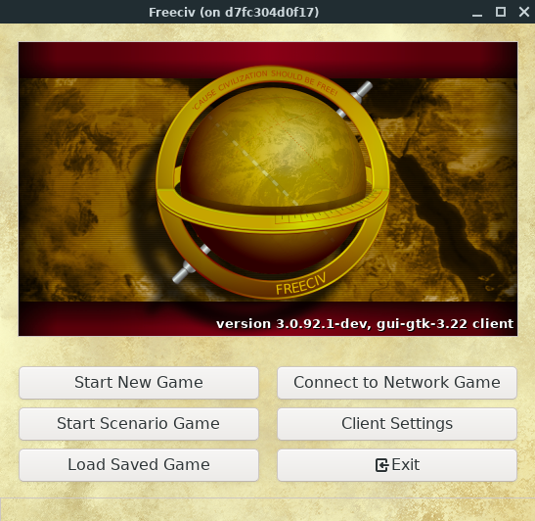
FreeCiv Development in a Docker Container
No dependencies to install!!

Slide 12
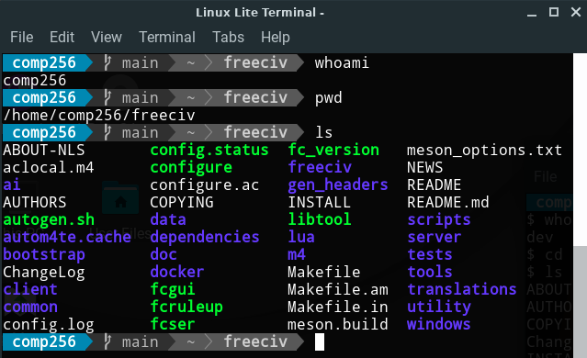
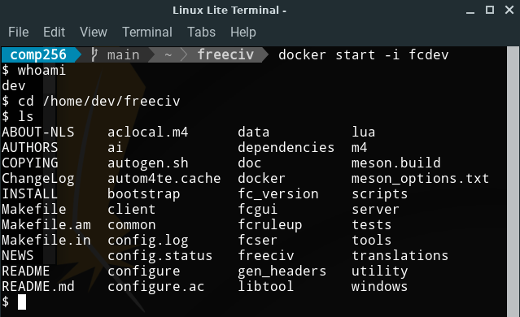
Docker in Linux Lite
Notes:
Two terminals
One will be Linux Lite (left)
The other will be connected to a container (right)
You’ll edit the files using Linux Lite – gui editor etc.
You’ll build in the container – it has all of the dependencies already installed.

Slide 13
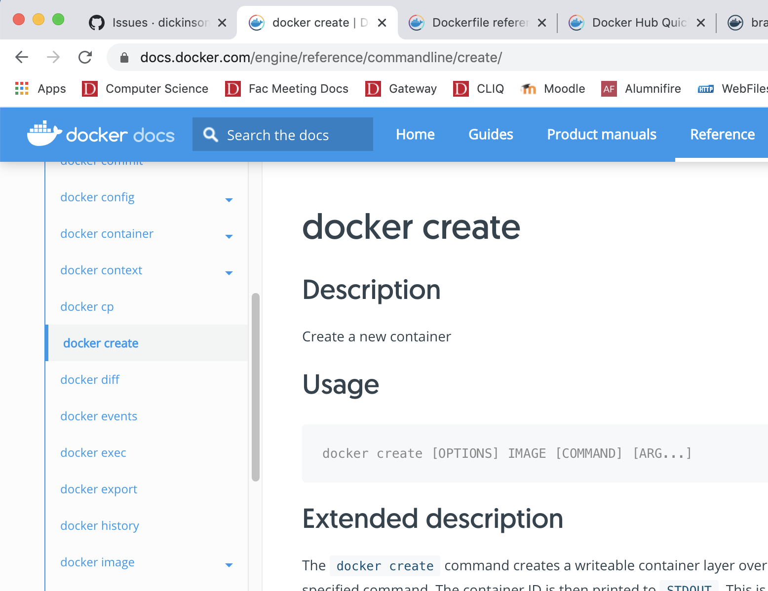
Docker Documentation
Notes:
Some of the exercises will ask you to use the documentation.
You’ll find commands on the left (e.g. docker create)
Then you’ll find their information on the right
A lot of it is dense. But I wanted you to see it and know its there.
We are just going to scratch the surface of docker.
If you want to do more, you’ll eventually need these docs.

Slide 14

Acknowledgments:
Slide Template From:
https://creativecommons.org/licenses/by/4.0/
Slide Content Licensed as:
https://creativecommons.org/licenses/by-nc/4.0/

